Slide 1

Module 3.9
IEC Language : Ladder

Slide 2
IEC Language ladder
Notes:
This page intentionally blank

Slide 3
Overview
The structure of a Ladder Diagram Section corresponds to a rung for relay switching.
The left power rail is located on the left-hand side of the LD editor. This left power rail corresponds to the phase (L ladder) of a rung. With LD programming, in the same way as in a rung, only the LD objects which are linked to a power supply, or connected with the left power rail, are "processed". The right-hand power rail corresponds with the neutral wire. However, all coils and FFB outputs are linked with it and this creates a power flow.
Complies with the IEC 61131-3 standard
A group of objects which are all linked together and have no links to other objects (excluding the power rail) is called a network or a rung.

Slide 4
Overview (cont)
The LD programming language is cell oriented, i.e. only one object can be placed in each cell.
One LD Section consists of a single paged window.
This page has a grid that divides the section into rows and columns.
A width of 11-64 columns and 17 - 2000 lines can be defined for LD sections.
The Process Sequence of the individual objects in an LD section is determined by the data flow within the section. Networks connected to the left power rail are processed from top to bottom (link with the left power rail). Networks that are independent of each other within the section are processed in order of positioning (from top to bottom).
Notes:
Ladder Diagram Objects:
The objects of the LD Programming Language help to divide a section into a number of:
Contacts
Coils.
EFs and EFBs (Elementary Functions and Elementary Function Blocks)
Procedures
Control Elements
Operation and Compare Blocks that represent an extension to IEC 61131-3
These objects can be connected with each other by means of:
Links or
Actual Parameters (FFBs only)
Comments can be provided for the logic of the section with text objects

Slide 5
See comments
Notes:
Additional Programming notes:
The objects of the LD programming language provide aids for the structuring of a section into a quantity of contacts, coils, and FFBs (elementary functions, elementary function blocks, Derived function blocks, user­defined functions, and user­defined function blocks). These objects are interconnected through actual parameters or links.
While being placed, the objects are aligned in the raster of the grid.
With the exception of vertical links, FFBs and text boxes, all elements need exactly one field of the grid.
When placing the contact and coils, they are automatically linked to an adjoining, unlinked contact/coil if the contact/coil is in the same vertical position. A link to the power rail will also be established if the contact is placed 2 fields away.
If contacts or coils are placed on already existing contacts or coils, the already existing ones will be replaced by the current ones (applies only to the same types, i.e. when replacing coils with coils and contacts with contacts).
If a coil or contact is placed on an already existing horizontal link, it will be automatically separated and the contact/coil is inserted. When creating links, overlaps and cross­overs with other links and objects are allowed.
If an FFB is selected, its comment will be displayed in the first column of the status line. If an actual parameter is selected, its name, and, if appropriate, its direct address and its comment will be displayed in the first column of the status line.

Slide 6
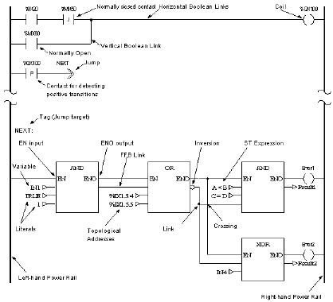
LD Section Example

Slide 7
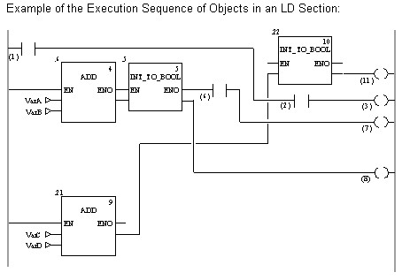
Execution Sequence
Rungs are executed from top to bottom and from left to right (see opposite example)
The execution sequence is indicated by the execution number (number in the top right corner of the FFB frame).
Note: The execution numbers for Contacts and Coils is not normally shown. They are shown only to provide a better overview.
See Comments for complete description of the Execution Sequence.
Notes:
Execution Sequence on Networks
For network execution sequences, the following rules apply:
Executing a section is completed network by network based on the object links from above and below.
Links may not be used to create loops since the sequence of execution in this case cannot be clearly determined.
Loops must be created using actual parameters.
The execution sequence of networks which are only linked by the left-hand power rail, is determined by the graphic sequence (from top to bottom) in which these are connected to the left-hand power rail.
This does not apply if the sequence is influenced by control elements. Processing on a network is ended completely before the processing begins on another network.
No element of a network is deemed to be processed as long as the status of all inputs of this element are not calculated.
Processing on a network is only ended if all outputs on this network have been processed. This also applies if the network contains one or more control elements.

Slide 8
See comments
Notes:
Signal Flow Within a Network
For signal flow within a network (rungs), the following rules apply:
The signal flow for Boolean links is:
left to right with horizontal Boolean links and
from top to bottom with vertical Boolean links
The signal flow with FFB links is from the FFB output to the FFB input, no matter which direction they are made in.
An FFB is only processed if all elements (FFB outputs, etc.) with which it's inputs are linked are processed.
The execution sequence of FFBs that are linked with various outputs of the same FFB runs from top to bottom.
The execution sequence of objects is not influenced by the location within the network.
The execution sequence for FFBs is represented as execution number by the FFB.
Priorities Priorities in Defining the Signal Flow Within a Section:

Slide 9
Change Execution Sequence
The order of execution in networks and the execution order of objects within a network are defined by a number of rules.
In some cases, the execution order suggested by the system should be changed.
The procedure for defining/changing the execution sequence of networks is as follows:
  Using Links Instead of Actual Parameters
  Network Positions
The procedure for defining/changing the execution sequence of objects within a network is as follows
Positioning of Objects
See Examples of these Rules under Comments
Notes:
Original Situation
The following representation shows two networks for which the execution sequences are only defined by their position within the section, without taking into account that block 0.4/0.5 and 0.7/0.8 require another execution sequence

Slide 10
See comments
Notes:
Link Instead of Actual Parameter
By using a link instead of a variable the two networks are run in the proper sequence. (see also Original Situation)
Network Positions The correct execution sequence can be achieved by changing the position of the networks in the section. (see also Original Situation)

Slide 11
See comments
Notes:
Positioning of Objects The position of objects can only have an influence on the execution order if several inputs (left link of Contacts/Coils, FFB inputs) are linked with the same output of the object "to be called" (right link of Contacts/Coils, FFB outputs). (see also Original Situation)
In the first network, block positions 0.1 and 0.2 are switched. In this case (common origins for both block inputs) the execution sequence of both blocks is switched as well (processed from top to bottom).
The same applies when switching coils C and D in the second network.
In the third network, block positions 0.4 and 0.5 are switched. In this case (different origins for the block inputs) the execution sequence of the blocks is not switched (processed in the sequence that the block outputs are called in). The same applies when switching coils G and H in the last network.

Slide 12
See comments
Notes:
In the third network, block positions 0.4 and 0.5 are switched. In this case (different origins for the block inputs) the execution sequence of the blocks is not switched (processed in the sequence that the block outputs are called in).
The same applies when switching coils G and H in the last network.

Slide 13
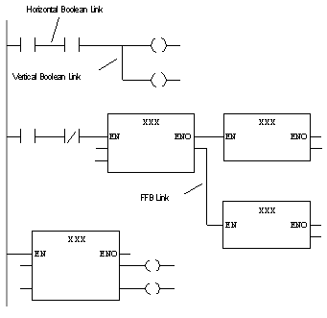
Ladder Diagram Links
Links are connections between LD objects (contacts, coils and FFBs etc.). There are 2 different types of Links:
  Boolean Links - consist of one or more segments linking Boolean objects (contacts, coils) with one another. There are 2 types of Boolean links as well:
    Horizontal Boolean Links - enable sequential contacts and coil switching.
    Vertical Boolean Links - enable parallel contacts and coil switching.
  FFB Links - FFB connections are combinations of horizontal and vertical segments that connect FFB inputs/outputs with other objects.
Notes:
General Programming Notes
Attention should be paid to the following general programming notes:
The data types of the inputs/outputs to be linked must be the same. Links between parameters with variable lengths (e.g. ANY_ARRAY_INT) are not allowed.
Several links can be connected with one output (right-hand side of one contact, one coil or one FFB output).
However, only one link can be connected with an input (left-hand side of one contact, one coil or one FFB output). Unconnected contacts, coils and FFB inputs are specified as "0" by default.
Links may not be used to create loops since the sequence of execution in this case cannot be clearly determined in the section. Loops must be created using actual parameters (see Loop Planning).
Notes on Programming Boolean Links
Overlapping Boolean links with other objects is not permitted.
The signal flow (power flow) is from left to right for Boolean links. Therefore, backwards links are not allowed.
If two Boolean links are crossed, the links are connected automatically. Since crossing Boolean links is not possible, links are not indicated in any special way.

Slide 14
See comments
Notes:
Notes on Programming FFB Links
At least one side of an FFB link must be connected with an FFB input or output.
To differentiate them from Boolean links, FFB links are shown with a doubly thick line. The signal flow (power flow) in FFB links is from the FFB output to the FFB input, no matter which direction they are made in. Therefore, backwards links are allowed. Only FFB inputs and FFB outputs may be linked to one-another. Linking more than one FFB outputs together is not possible. That means that no OR connection is possible in LD using FFB links.
Overlapping FFB links with other objects is permitted. Crossing FFB links is also permitted. Crossed links are indicated by a "broken" link.
Connection points between more FFB links are shown with a filled circle.
To avoid links crossing each other, FFB links can also be represented in the form of connectors.
The source and target for the FFB connection are labeled with a name that is unique within the section. The connector name has the following structure depending on the type of source object for the connection:
For functions: "Function counter/formal parameter" for the source of the connection

Slide 15
See comments
Notes:
For function blocks: "Instance name/formal parameter" for the source of the connection
For contacts: "OUT1_sequential number »
Vertical Links
The "Vertical Link" is special. The vertical link serves as a logical OR. With this form of the OR link, 32 inputs (contacts) and 64 outputs (coils, links) are possible.

Slide 16
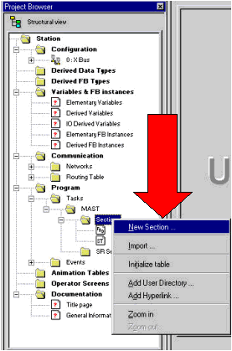
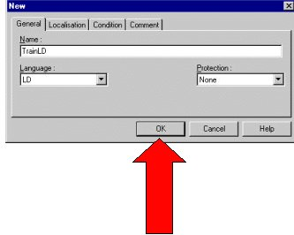
Creating a Ladder Diagram Section
Notes:
Creating a Ladder Diagram Section
Unlinked contacts, coils, and inputs/outputs of FFBs are assigned the default value ”0”.
A large amount of logic in form of Macros can also be placed in your LD section.
Text can also be placed in an LD section.
Text objects are not allowed to overlap with other objects, although they may overlap with links.
Text objects do not occupy space in the Quantum PLC because the text is not loaded into the Quantum.
The processing order of the individual objects in an LD section is determined by the data flow within a section. Rungs attached to the left power rail are processed top to bottom (connection to left power rail). Rungs within the section that are independent of each, are processed in the order of placement.

Slide 17
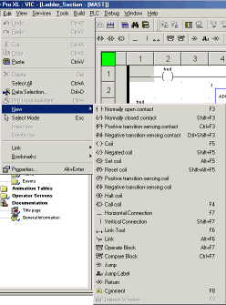
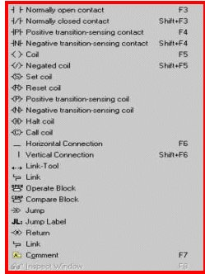
Programming Objects
There are 3 methods of accessing Ladder Diagram Programming Objects:
  Click “Edit”, then “New”…….

Slide 18
Programming Objects - The Toolbar
There are 3 methods of accessing
Ladder Diagram Programming Objects:
  Click “Edit”, then “New” …….
  Use the Ladder Diagram Objects Toolbar

Slide 19
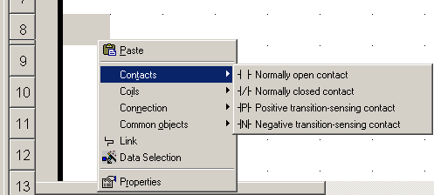
Programming Objects
There are 3 methods of accessing Ladder Diagram Programming Objects:
  Click “Edit”, then “New” …….
  Use the Ladder Diagram Objects Toolbar
  Place the cursor on any empty Logic Editor cell, then Right Click to select Object groups

Slide 20
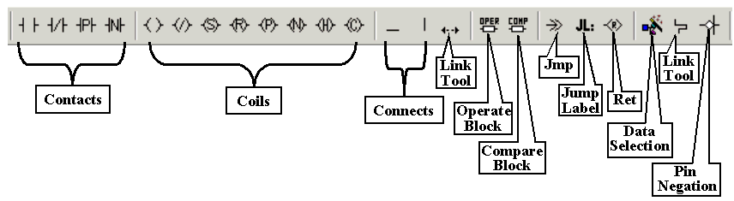
Programming Objects - Toolbar

Slide 21
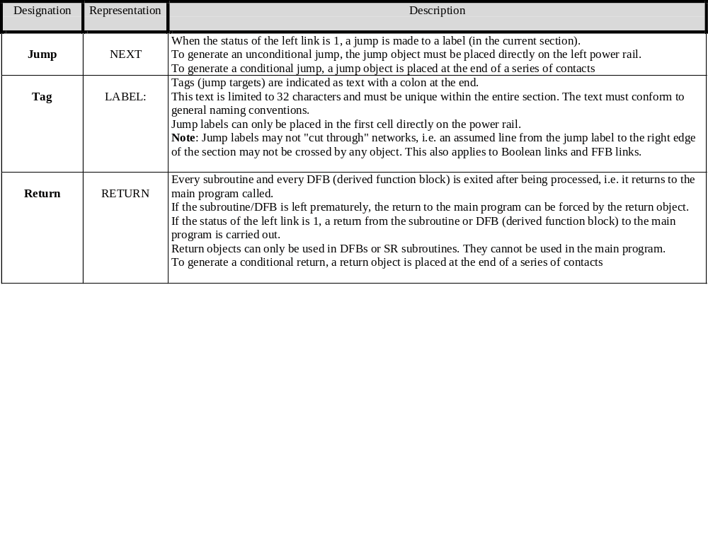
Ladder Control Elements
Control Elements are used for executing jumps within an LD Section and for returning from a sub-routine(SRx) or derived function block (DFB) to the main program. Control Elements take up one cell.

Slide 22




Operation & Compare Blocks
In addition to the objects defined in IEC 61131-3 there are two other blocks for executing ST instructions and ST expressions and for simple compare operations. These blocks are only available in the LD programming language. They are called:
OPERATE Block
COMPARE Block

Slide 23
Operate Blocks
Operate Blocks are only available in the LD programming language. They are used to execute an ST instruction. When the status of the left link is a 1, the ST instruction in the block is executed.
All ST instructions are allowed except the control instructions:
    RETURN, IF, FOR
    JUMP, CASE, etc.)
For Operate Blocks, the state of the left link is passed to the right link (regardless of the result of the ST instruction).
  Operate Blocks can be placed in any free cell. An Operate Block requires 1 line and 4 columns.
  If an Operate Block is placed in a cell that is already occupied by an object, an error message is returned.
A placed operate block automatically creates a connection with its
neighboring objects on the left if they are of the BOOL data type
and there are no free cells between them. See Additional Comments
Notes:
An Operate Block can contain up to 4096 characters. If not all characters can be displayed then the beginning of the character sequence will be followed by an apostrophe (...).
A placed Operate Block automatically creates a connection with its neighboring objects on the left if they are of the BOOL data type and there are no free cells between them.
Activating Operate Block Placement Mode
Operate Block placement mode can be activated in the following ways:
Use the menu command Edit -> New -> Operate Block,
Use the menu command Common Objects -> Operate Block in the shortcut menu,
Use the key combination Alt+F7, or
Select the symbol .
The active Operate Block placement mode is indicated by the cursor symbol .
Note : In the Tools -> Options dialog box on the Data and Languages tab, if the check box, Automatically assign a variable to a new graphical object is selected, then the corresponding properties dialog box is automatically opened when an object is placed. The procedures explained here are also valid for deactivated check boxes.

Slide 24
See comments
Notes:
Placing an Operate Block
Placing an Operate Block
Placing several Operate Blocks
Placing several Operate Blocks:

Slide 25
See comments
Notes:
Defining the Operation
Defining the operation:

Slide 26
Compare Blocks
Compare Blocks are only available in the LD programming language.They are used to execute a compare expression (<, >, <=, >=, =, <>)in the ST programming language. (Note: the same functionality is also possible using ST expressions)
If the state of the left link is a 1 and the result of the comparison is a 1, the state of the right link is a 1.
Compare blocks can be placed in any free cell except the last cell directly on the right power rail.
A compare block requires 1 line and 2 columns.
If a compare block is placed in a cell that is already occupied by an object, an error message is returned.
A placed compare block automatically creates a connection with its neighboring objects on the left and right if they are of the BOOL data type and there are no free cells between them. See Additional Comments
Notes:
Additional Notes
A Compare Block can contain up to 4096 characters. If not all characters can be displayed then the beginning of the character sequence will be followed by an apostrophe (...).
Activating Compare Block Placement Mode
Compare Block placement mode can be activated in the following ways:
Use the menu command Edit -> New -> Compare Block,
Use the menu command Common Objects -> Compare Block in the shortcut menu,
Use the key combination Ctrl+F7, or
Select the symbol .
The active Compare Block placement mode is indicated by the cursor symbol .
Note :
If inTools -> Options the Data and Languages tab, if the check box, Automatically assign a variable to a new graphical object is selected, then the corresponding properties dialog box is automatically opened when an object is placed. The procedures explained here are also valid for deactivated check boxes.

Slide 27
See comments
Notes:
Placing a Compare Block
Placing a Compare Block:
Placing several Compare Blocks
Placing several Compare Blocks:

Slide 28
See comments
Notes:
Defining the Compare Operation
Defining the Compare operation:

Slide 29
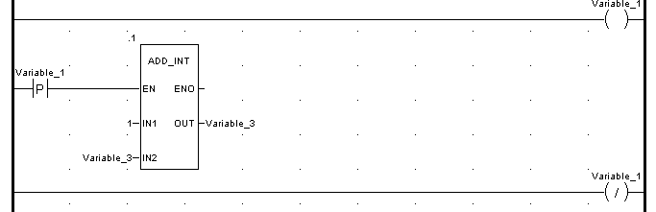
Edge Detection Objects
Different implementation (system call versus FB call) of LD objects request the usage of StateRam variables (0x/1x registers).
  Under the condition that several write access to the 0x/1x register are possible in a scan a different online behavior may apply.
    Affected objects: contact with raising edge
    contact with falling edge
Notes:
In Concept the coil transition objects have been made available as EFB call RTRIG/FTRIG. The necessary “old state” information to detect an edge is associated with the EFB call and evaluated/updated only at its execution once per cycle.
In Unity the edge detection objects are only usable with EBOOL variables. The “old state” is associated directly to this enhanced boolean datatype. %M and %I registers are always of the type EBOOL. The update of the “old state” information occurs at every write access to the EBOOL variable.

Slide 30
Example of Edge Detection Objects
Initial values: %QX1 equals FALSE. %QW=1
Notes:
Concept:
First cycle: %QW1 is incremented from 1 to 2.
Next cycle(s): %QW1 remains at value 2 as the transition edge always compares its old state(TRUE) against the actual (TRUE)
Unity:
All cycle(s): %QW1 is incremented by 1. The transition edge always recognizes that in the last write access was a positive transition edge
Caution:
Use the edge detection objects if possible with 0x/1x variables. Do not write to 0x registers more than once in a cycle if this register is attached to the LD objects with raising/falling edge (e.g. ---|P|---) to ensure the same online behavior in Concept and Unity.
Within Unity DFBs, please substitute the edge detection functionality with R_TRIG and F_TRIG EFBs (not usable within the LD editor of Concept).

Slide 31
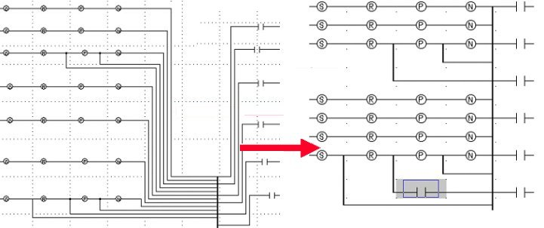
Ladder Diagram
Respect a grid representation for all objects including links and short circuits This is exaggerated example)
Notes:
A conversion of the graphics is done by the Unity converter which may result in graphical readjustments. Below are the main rules of the conversion process in order to minimize a rearrangement during the future conversion process.
1) Grid oriented representation in Unity (as in Concept 2.2 or higher). Links also respect the grid representation.
2) The notation of a right power rail is introduced. The rightmost elements in a row are directly placed/adjusted close to this power rail.
3) Cross links (with no connection) are not allowed in Unity. In case of link crossing conflicts additional elements are inserted into the Unity diagram. The execution order of the elements is kept up.
4) Optimizations like eliminating blank spaces or rearranging some areas of the ladder diagram will be done.
5) The coil is the rightmost object – only one can be placed per network.
Unity will do graphical readjustment. Please look at the following examples to anticipate the scope of changes and avoid its impact on your application.

Slide 32
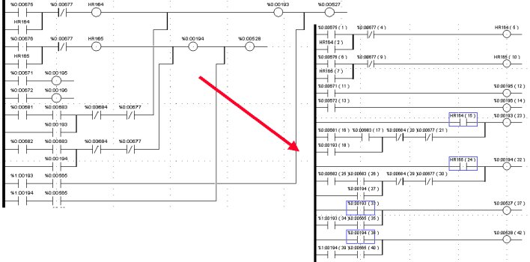
Eliminate crossings
Notes:
1) For Concept 2.1 or earlier (free floating graphic): Respect a virtual grid
representation for short circuit objects. For Concept 2.2 or later (grid representation): Respect the grid
representation with the links and short circuits.
2) Place the final element in the row always in the same column.
3) Avoid link crossings and backward connections
4) Keep a straightforward structure in your application

Slide 33
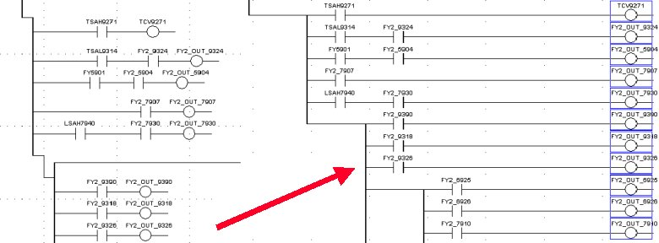
Avoid islands with short-circuits and links :
Select coils are attached to right power rail
Vertical shorts have same thickness as horizontal links

Slide 34
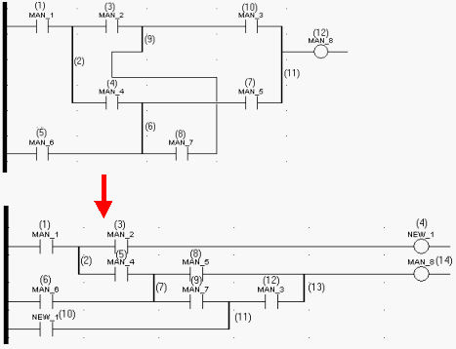
Avoid link crossing and backward connections
Backward Connection needs crossing, since selected coil must be attached to power rail.

